Slide 1
Jigsaw Multilingual Toxic Comment Classification
Aashish Acharya, Cosima Birkmaier, Philip Bramwell
opencampus.sh
24W | Intermediate Machine Learning

Slide 2
Trigger Warning & Disclaimer
The project deals with toxic language. The presentation may therefore (for purely academic purposes) contain toxic - particularly offensive, obscene, threatening or hateful content. It is not our intention to offend anyone in the audience or anyone's mother.

Slide 3
Objective
Predict the probability of a comment text being toxic
“Toxic” includes:
Hate speech
Harassment
Insults
Abusive language

Slide 4
Dataset
Comments from Wikipedia talk pages & Civil Comments platform
Training set:
223,549 samples
8 columns: id, comment, toxic, severe_toxic, obscene, threat, insult, identity_hate
Label: column ‘toxic’
All comments in English
Validation set:
8,000 samples
Comments in 3 languages (Turkish, Spanish, Italian)
Test set:
63,812 samples
Comments in 6 languages (Turkish, Spanish, Italian, Russian, Portuguese, French)

Slide 5
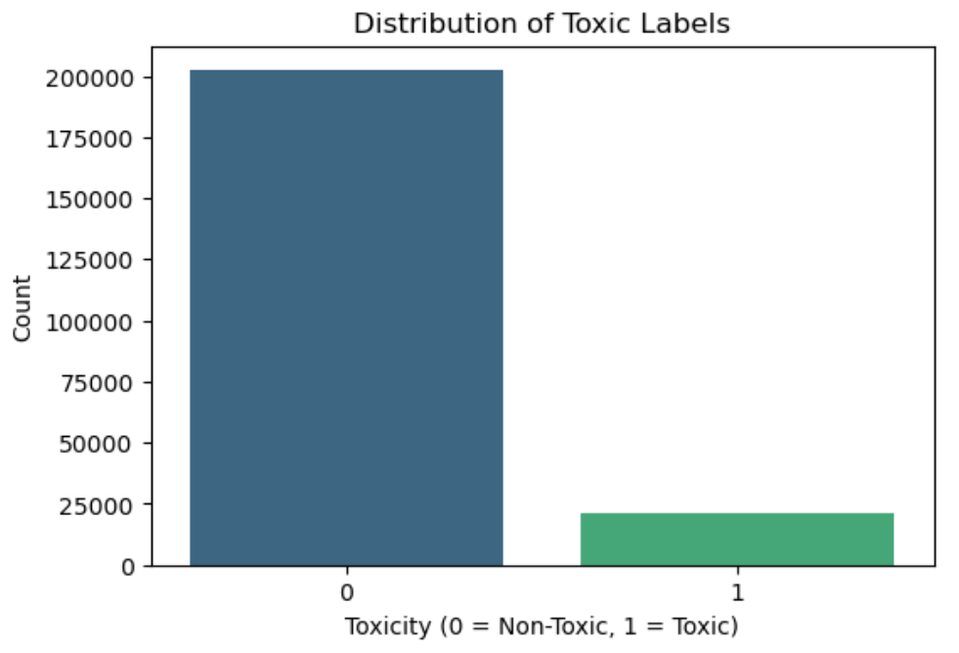
Challenge: Imbalance of Class Distribution
Class distribution:
202,165 (90.4%) non-toxic
21,384 (9.6%) toxic
Techniques to address this:
Undersampling
Random Oversampling
Data Augmentation:
Translation & Back-Translation
Contextual augmentation
ROC-AUC metric (Receiver Operating Characteristic - Area Under the Curve)

Slide 6
Challenge: Different Sets of Languages
Training set:
English
Validation set
Turkish, Spanish, Italian
Test set
Turkish, Spanish, Italian, Russian, Portuguese, French
Methods to address this:
Use of translations
Use XML-RoBERTa model
Pre-trained on >100 languages
Recognizes languages automatically
Preferred by most successful participators of the Kaggle competition

Slide 7
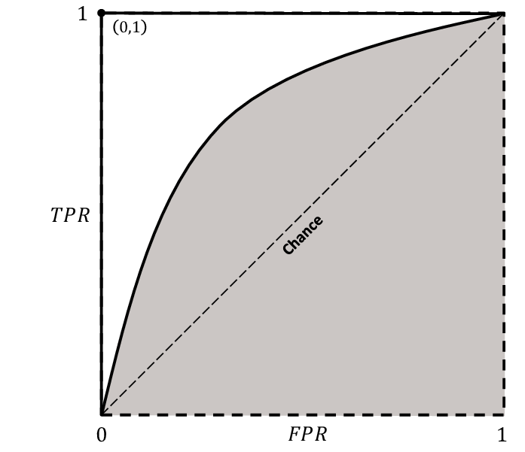
ROC-AUC
ROC Curve:
Plots True Positive Rate (TPR) vs. False Positive Rate (FPR) across Classification thresholds.
AUC:
1: Perfect separation.
0.5: Random guessing (diagonal line).
Why use it?:
Threshold-independent performance metric.
Robust for imbalance datasets.
https://www.researchgate.net/figure/ROC-curve-with-AUC-shaded-in-gray_fig7_367283054

Slide 8
Contextual Augmentation
Definition and core concept
Generates synthetic training samples by leveraging contextual understanding
Focuses on preserving semantic meaning while altering text
Implementation
Bidirectional Encoder (BERT) Model
Probability of 60%
Maximal 10 word substitutions in a sequence
Handling imbalanced dataset
Generating only toxic comments

Slide 9
Translation and Back-Translation
Translate toxic training comments from English to 6 different languages
Translate each translation back to English
Implementation:
deep_translator GoogleTranslator
Accesses GoogleTranslator online
Very time consuming
Susceptible to failure
12,636 original toxic training samples were used
151.632 new, augmented samples

Slide 10
Sen pis bir orospusun git kendini becer
You're a dirty whore go fuck yourself
Ты грязный ублюдок иди нахуй
You are a dirty bastard go fuck yourself
Sei un fottuto stronzo vai a farti fottere
You're a fucking asshole Go fuck yourself
Your are a filthy fuck go fuck your self
Tu es un sale connard va te faire foutre
You're a dirty asshole fuck you
Você é um filho da puta imundo vai se foder
You're a filthy son of a bitch fuck you
Eres un asqueroso cabrón vete a la mierda
You are a disgusting bastard go to hell

Slide 11
Baseline Model: Architecture
RNN Baseline Model
Embedding Layer: Maps words/tokens to 100 dimensional vectors
RNN Layer: 128 hidden units
Classification Head: Sigmoid output for binary prediction
Training Details:
Loss: BCEWithLogitsLoss
Optimizer: Adam (lr=0.001)
Epochs: 5
Evaluation:
Accuracy on test set/split: 90.40% (trained on reduced dataset of 10,000 samples)
Test AUC: 0.5275

Slide 12
DistilBERT
Trained on small subset of 5,000 samples
Tokenized data with DistilBERTs own tokenizer
1 epoch, batch size = 8, learning rate = 2e-5
ROC-AUC: 0.7287

Slide 13

XLM-RoBERTa with Undersampling
Original dataset size: 223,549
Balanced dataset size: 42,768
Toxic comments: 21,384
Non-toxic comments: 21,384
Filtering comments exceeding max token limit 512
1072 comments removed from training dataset
2 epochs, batch size = 8, learning rate = 2e-5

Slide 14
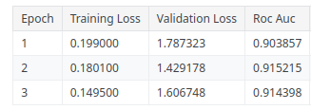
XLM-RoBERTa with Contextual Augmentation
Trained for 3 epochs
Potentially overfitting to the training data
ROC-AUC as metrics
Measures the model's ability to discriminate between classes across all thresholds
Reflects overall ranking performance
ROC-AUC of test set: 0.8934

Slide 15
XLM-RoBERTa with Translations & Back-Translations
All augmented comments
Large dataset with 375,181 samples
2 epochs, batch size = 128, learning rate = 2e-5
ROC-AUC: 0.7580
Problems with overfitting
Only translations & undersampling
194,400 samples
2 epochs, batch size = 32, learning rate = 3e-5
ROC-AUC: 0.7687
Only back-translations & undersampling
194,400 samples
2 epochs, batch size = 32, learning rate = 3e-5
ROC-AUC: 0.8269

Slide 16
Comparison
Model | Augmentation / Address imbalance | ROC-AUC
Baseline (RNN) | - | 0.5275
DistilBERT | - | 0.7287
XLM-RoBERTa | Undersampling | 0.9116
XLM-RoBERTa | Translation & Back-Translation | 0.7580
XLM-RoBERTa | Translation & undersampling | 0.7687
XLM-RoBERTa | Back-Translation & undersampling | 0.8269
XLM-RoBERTa | Contextual Augmentation | 0.8934

Slide 17
Summary
Results are not satisfying so far
Some data augmentation methods (like translation) seem to decrease performance
Undersampling was so far the best performing method

Slide 18
Sources
Kobayashi, S. (2018): Contextual augmentation: Data augmentation by words with paradigmatic relations. arXiv preprint arXiv:1805.06201
Shleifer, S. (2019): Low Resource Text Classification with ULMFit and Backtranslation. https://arxiv.org/abs/1903.09244
Wu, X. & Lv, S. & Zang, L. & Han, J. & Hu, S. (2019). Conditional BERT Contextual Augmentation. 10.1007/978-3-030-22747-0_7

Slide 19
XLM-RoBERTa on Subset of Training Set
Trained on reduced dataset (10,000 samples)
3 epochs
Cross validation loss: 0.0977
Recall: 0.90

Slide 20
Baseline model: Data Preprocessing
Text Cleaning
Convert text to lowercase
Split sentences into tokens
Vocabulary Building
Created a dictionary with top 10000 frequent words (Index Mapping)
<PAD> (padding) and <UNK> (unknown) tokens
Sequence Handling:
Pad/truncate all texts to fixed length
Rare words replaced with <UNK>

Slide 21
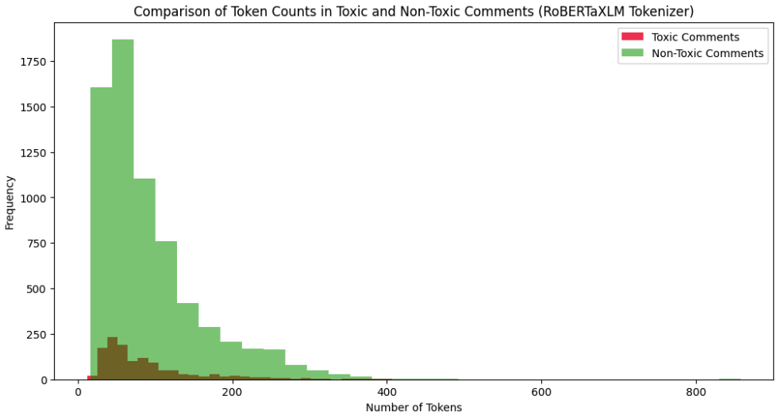
XLM-RoBERTa continue..
Filtering out comments
Analyzed token lengths
Filters comments exceeding 510 tokens (to fit the model’s 512-token limit).
1,072 training samples removed
1 validation sample removed

Slide 22
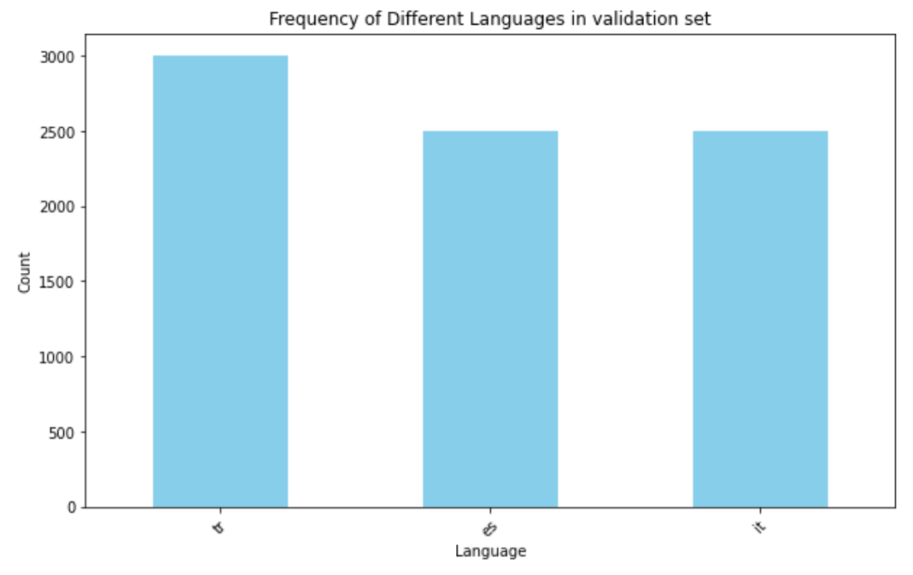
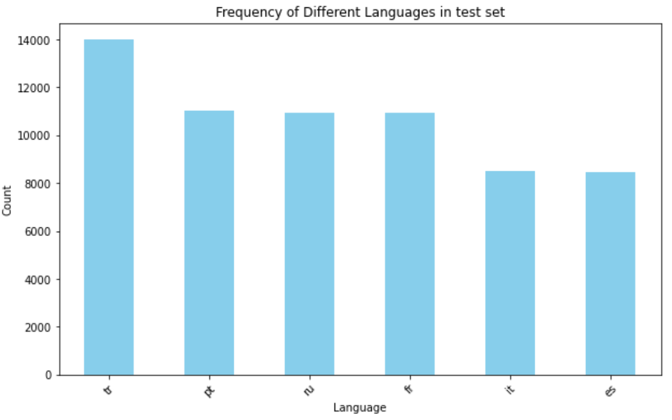
Exploratory Data Analysis
Different sets of languages:
Training set:
Only English
Validation Set
Turkish
Spanish
Italian
Test Set
Turkish
Spanish
Italian
Russian
Portuguese
French

Slide 23
